Slide 1
Project Power BI

Slide 2
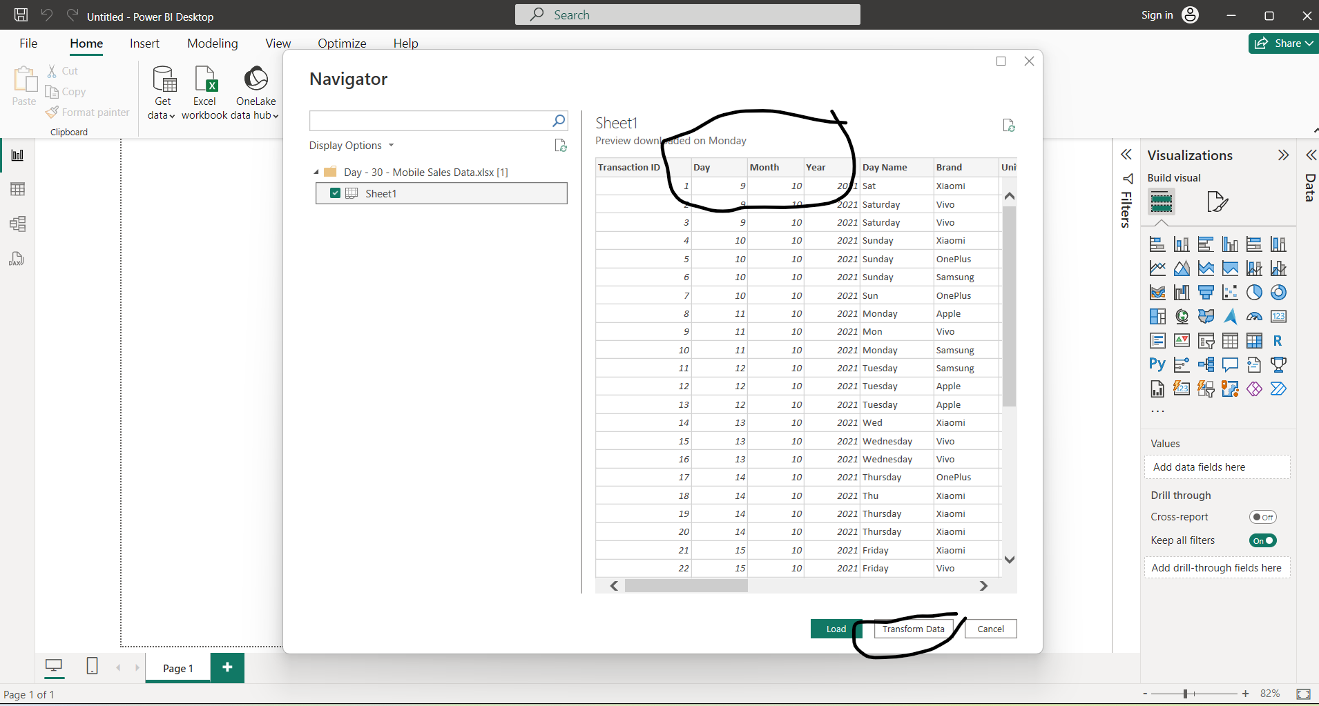

Slide 3
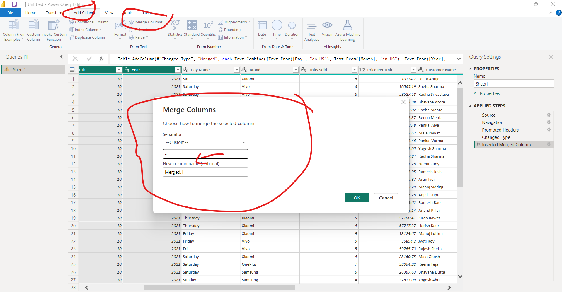
Fill Merge Form

Slide 4
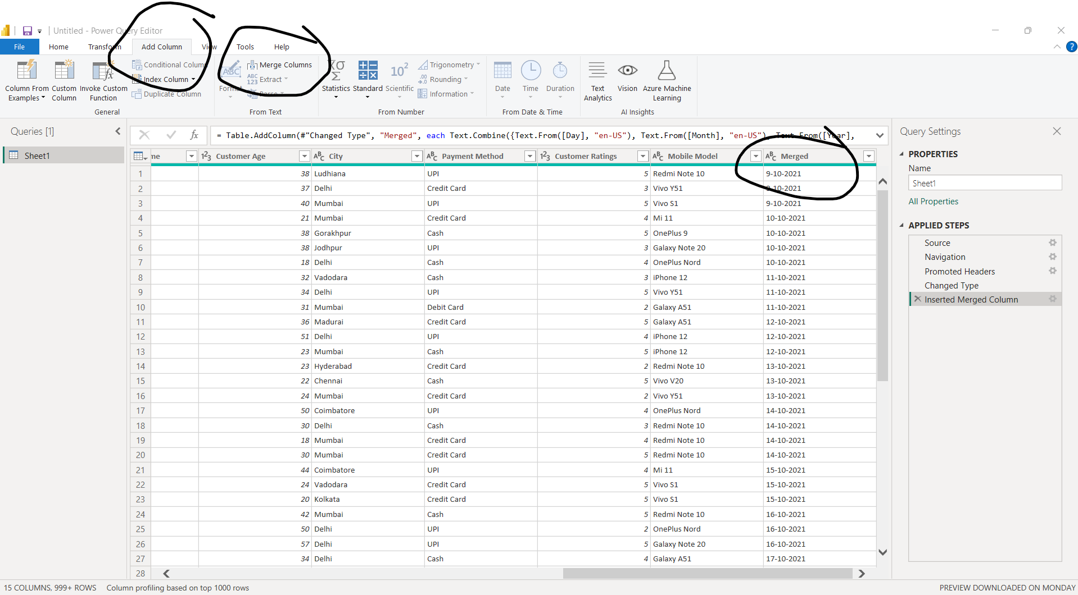
Merge the separate columns of Data, Month and Year

Slide 5
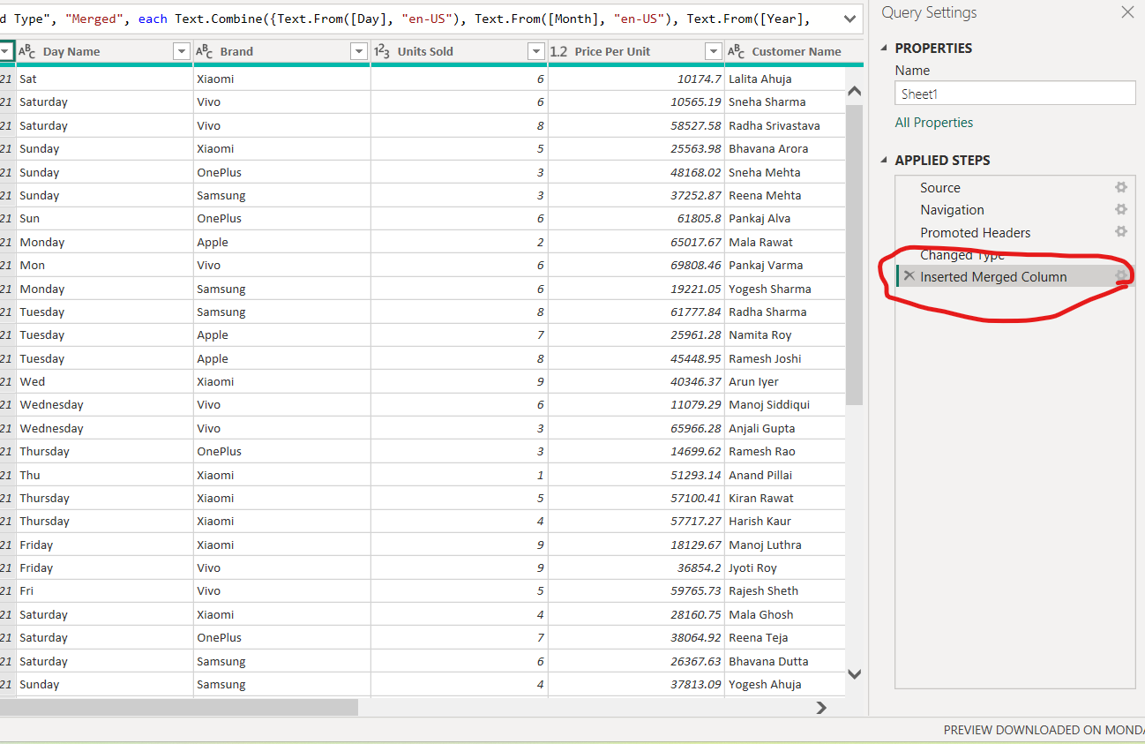
Query applied

Slide 6
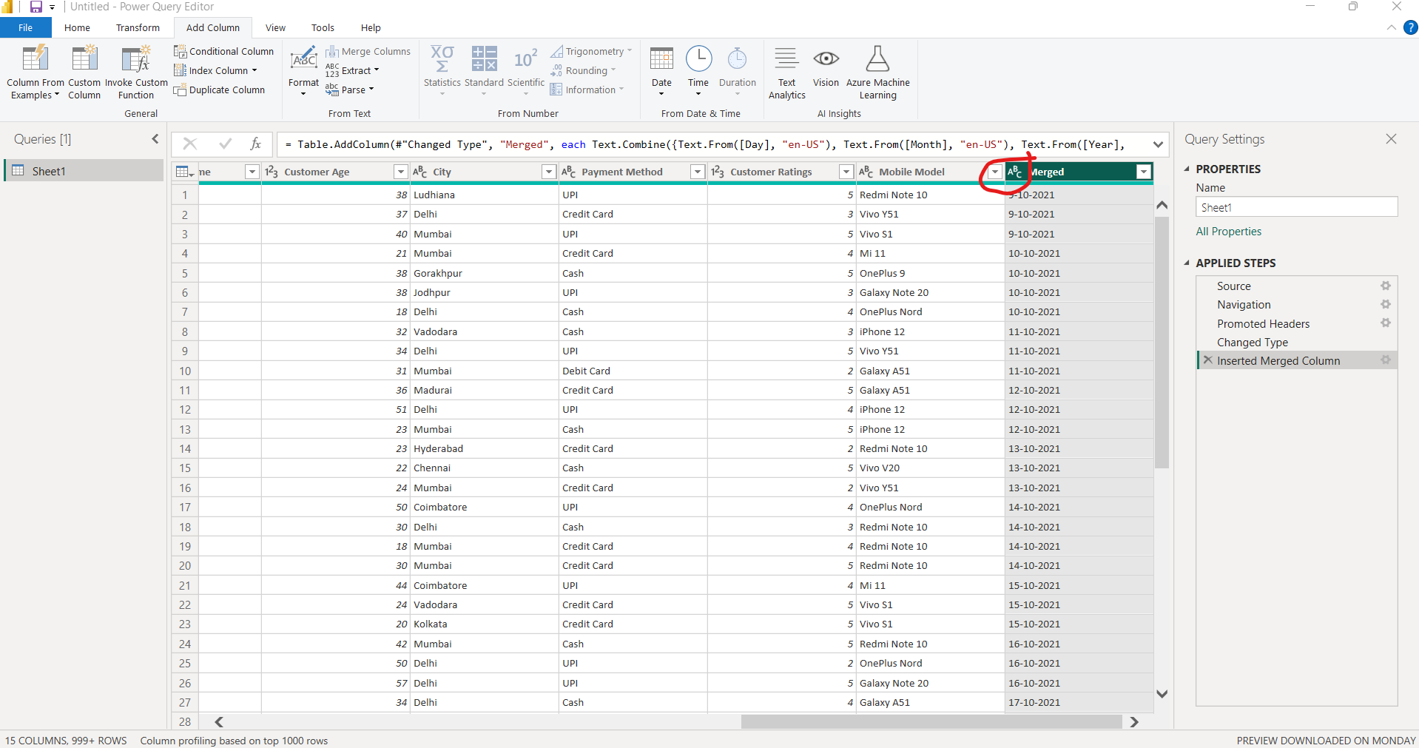
Change data type to “Date”by clicking on the column header side

Slide 7
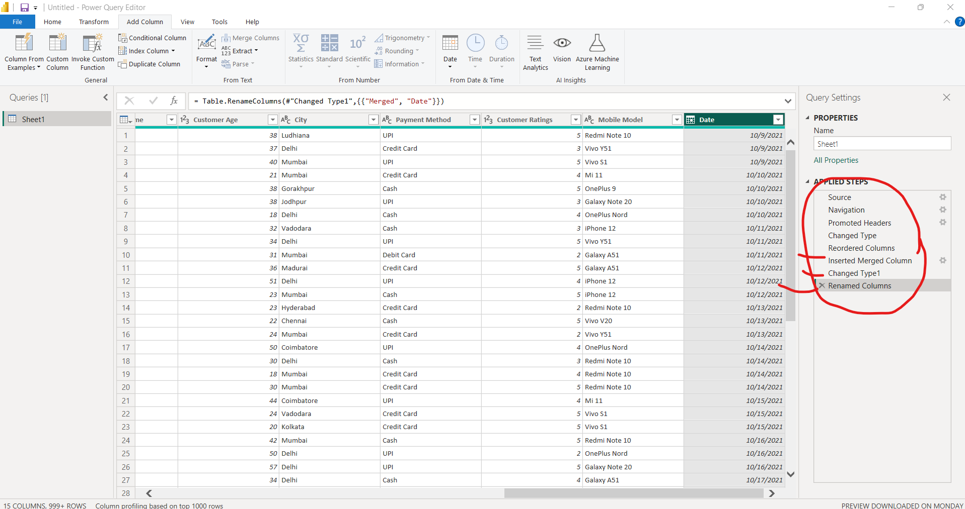

Slide 8
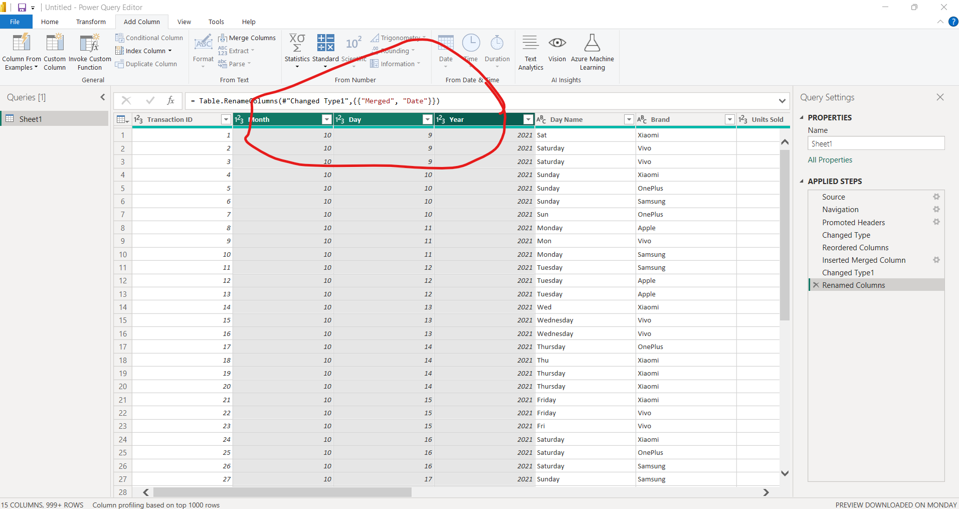
Remove these columns

Slide 9
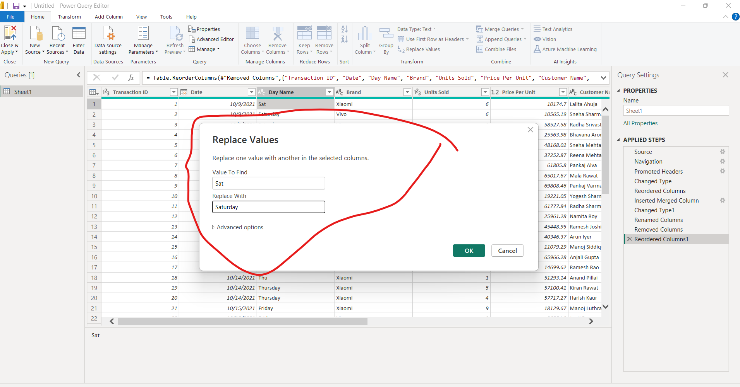
Replace Value-> Clean Data

Slide 10
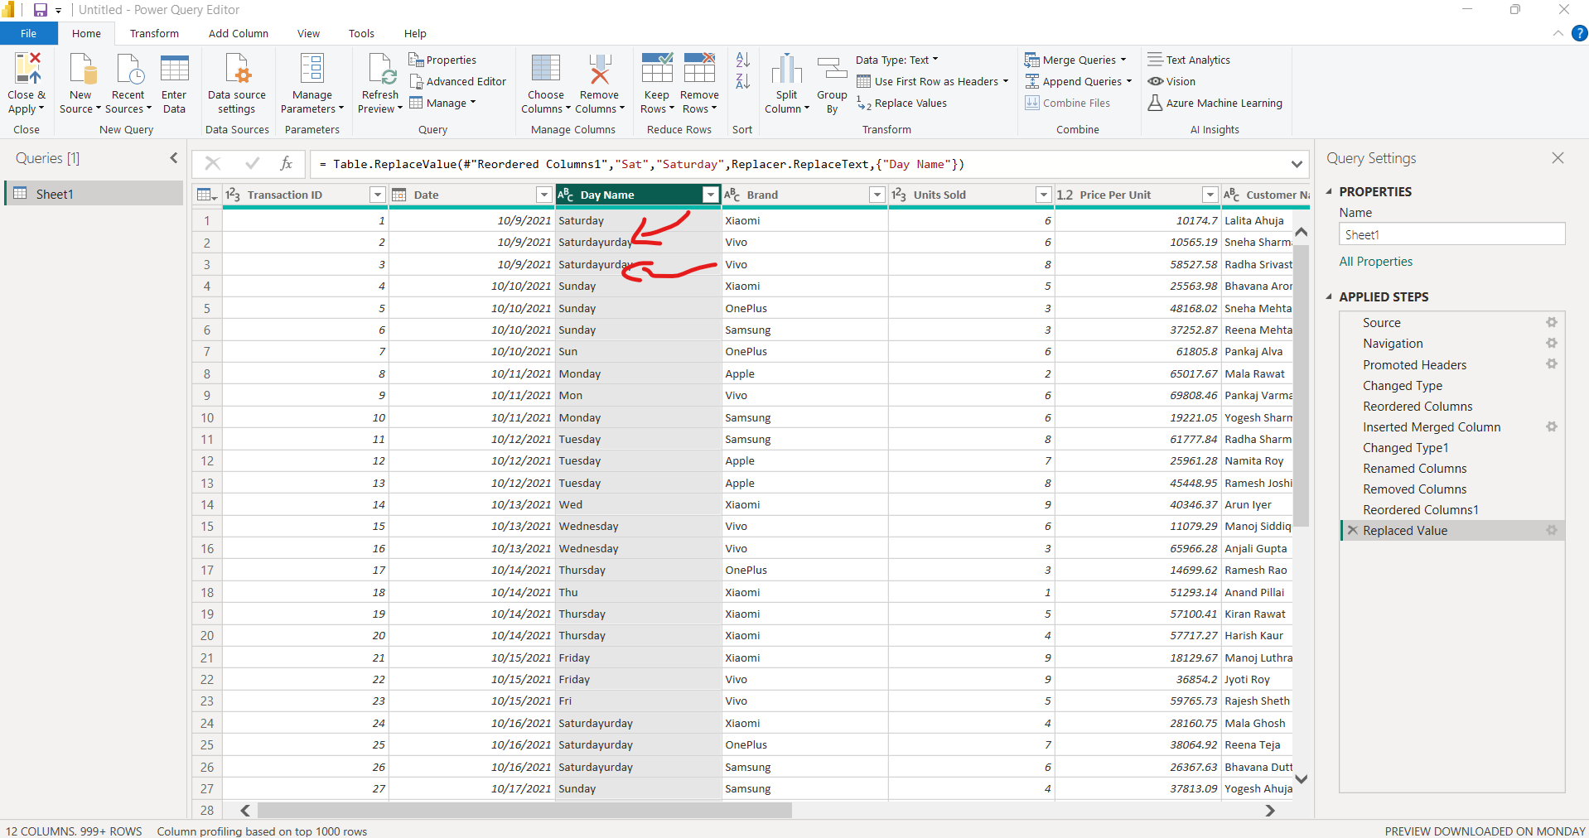
Create further problem

Slide 11
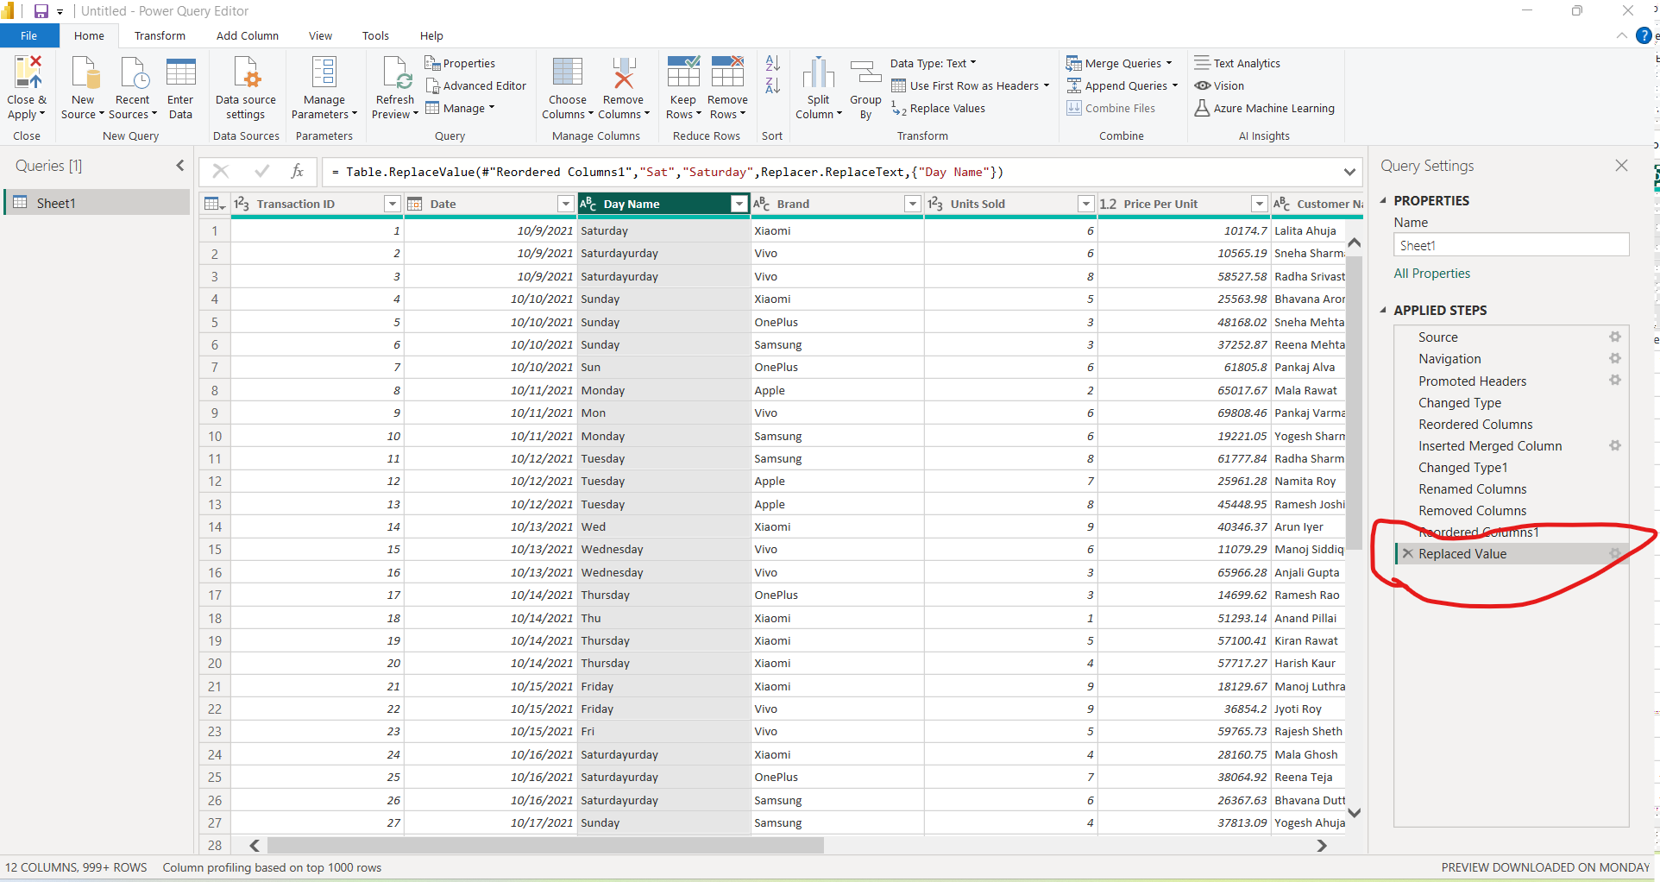
Undo the Query

Slide 12
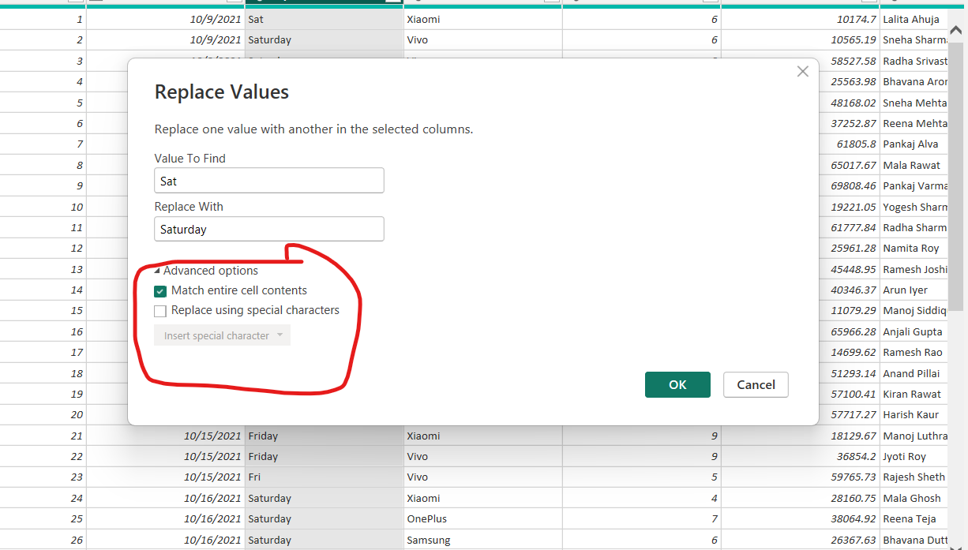
Now replace again using advance option using Checking “Match Entire cell contents”

Slide 13
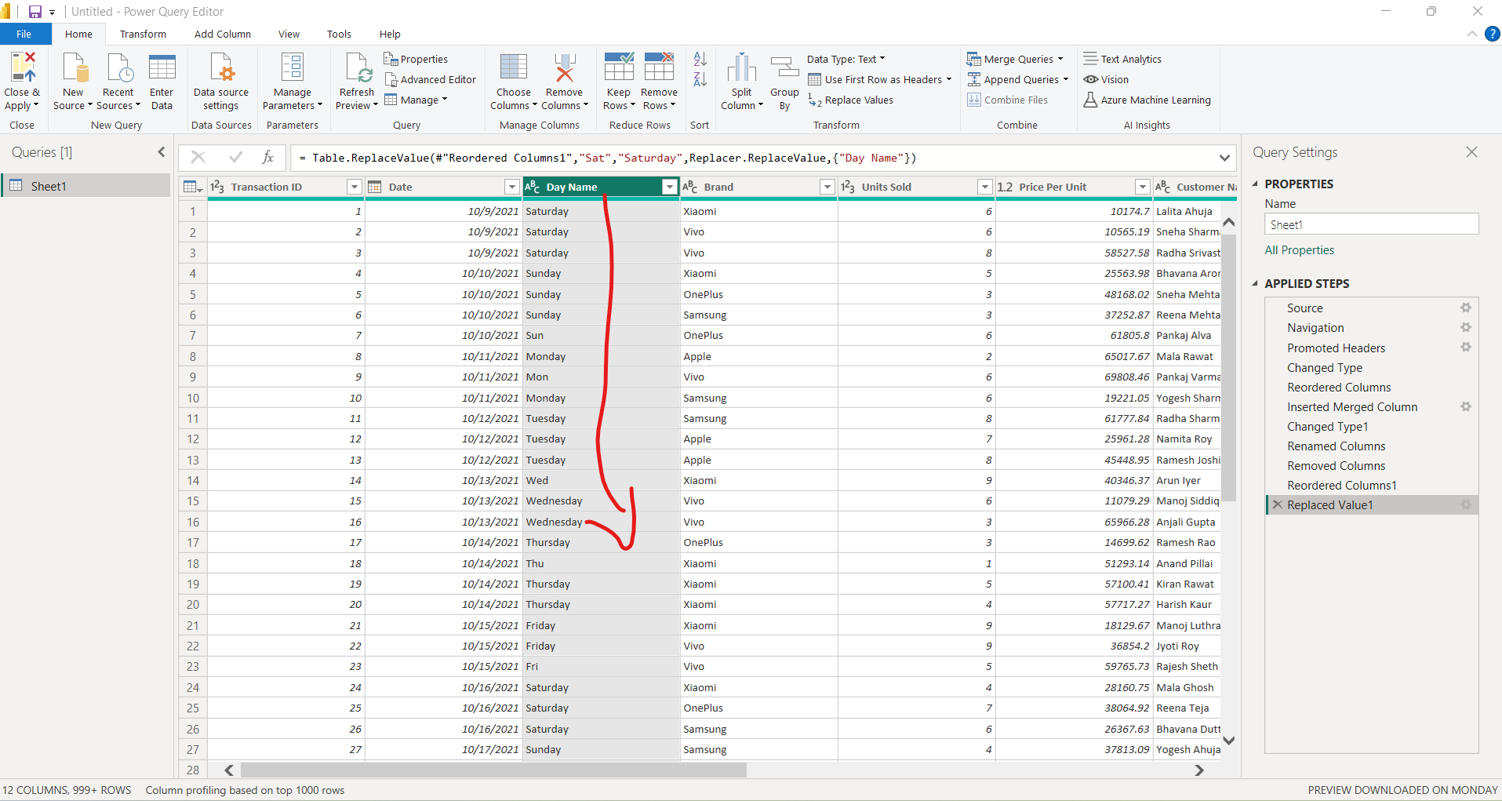
Change is reflected

Slide 14
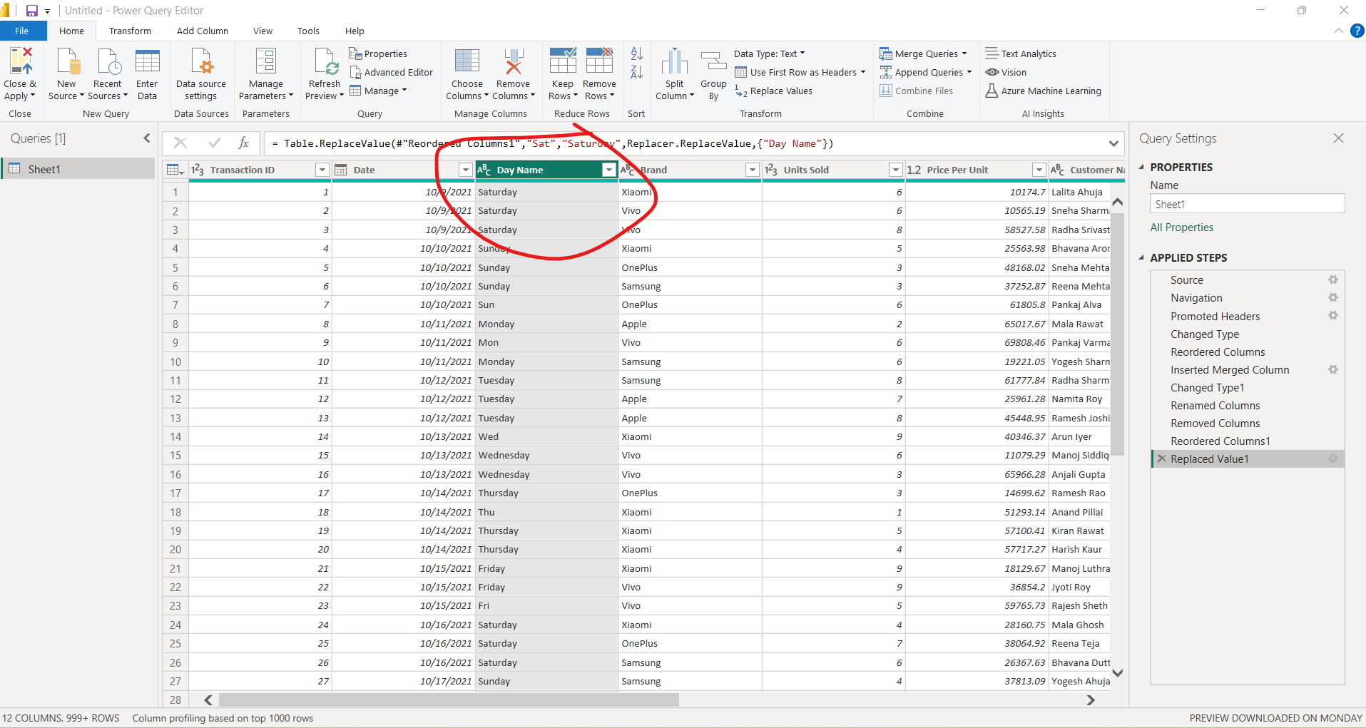
Now remove this column as its no longer req

Slide 15
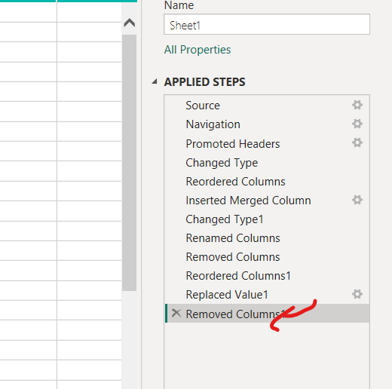
Removed

Slide 16
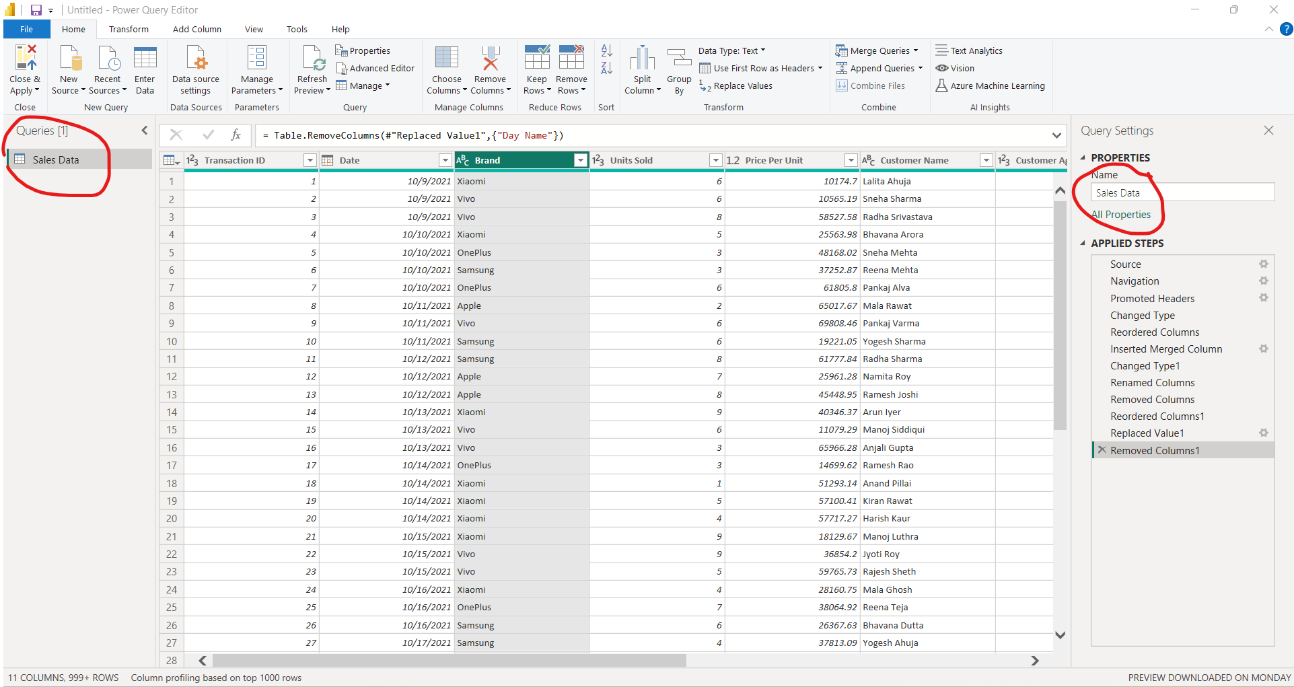
Rename the sheet1 name

Slide 17
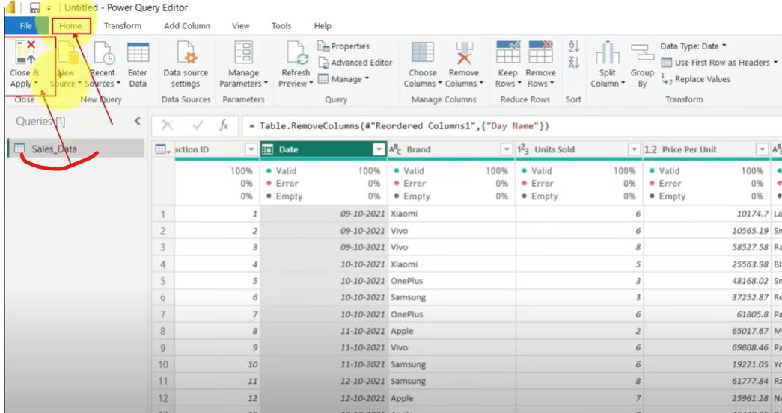
Change its name sales data and Close n Apply

Slide 18
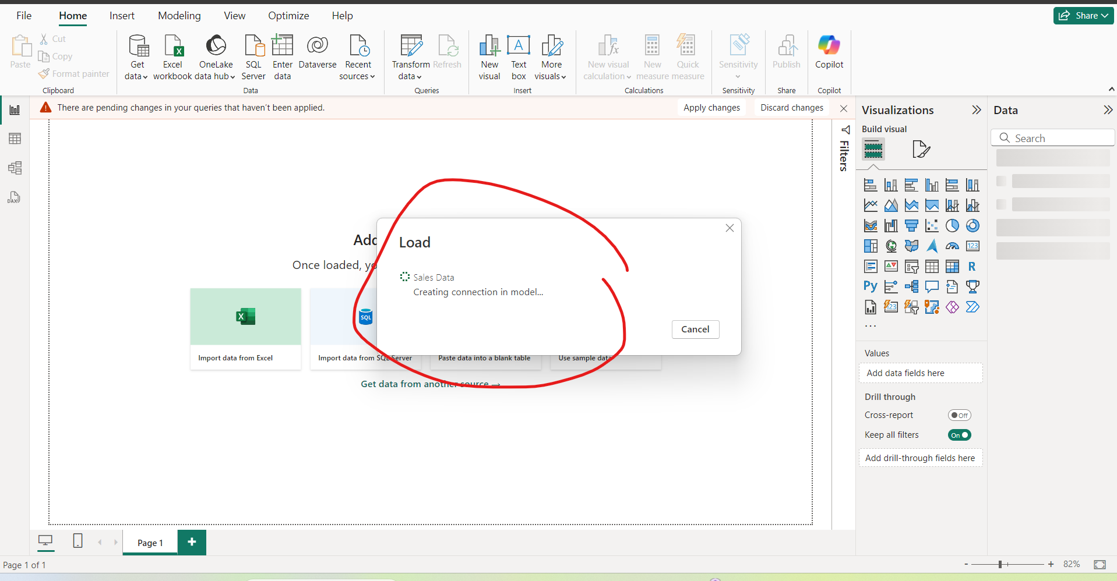
Data automatically starts loading

Slide 19
Create a custom calendar

Slide 20
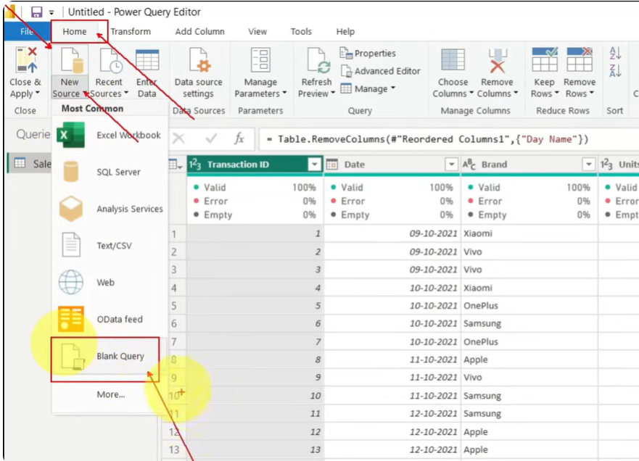

Slide 21
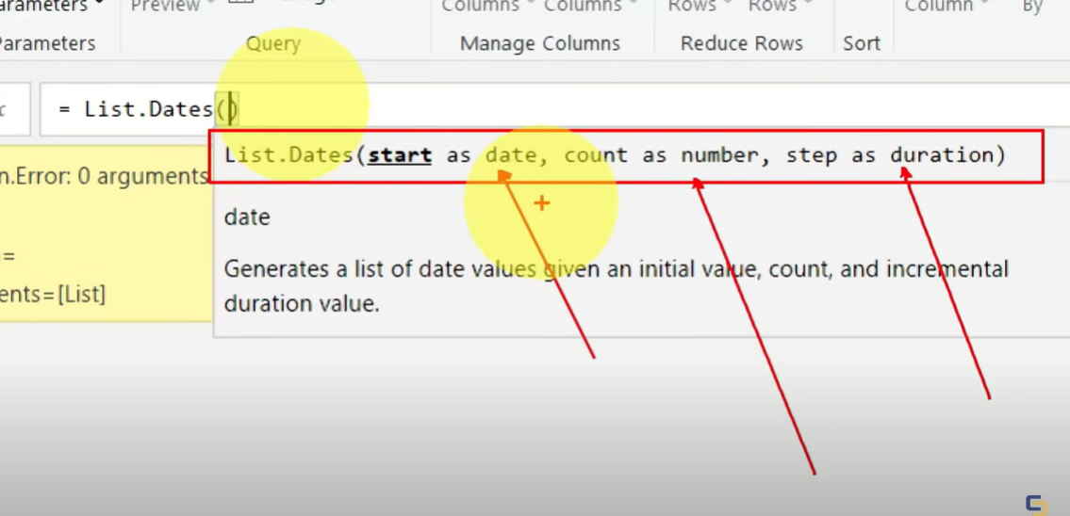
On a formula bar write

